Slide 1

Mandarin Beginner
Dandan Lyu
2017.05.16
summerlyu1993@gmail.com
Notes:
This template can be used as a starter file for presenting training materials in a group setting.
Sections
Right-click on a slide to add sections. Sections can help to organize your slides or facilitate collaboration between multiple authors.
Notes
Use the Notes section for delivery notes or to provide additional details for the audience. View these notes in Presentation View during your presentation.
Keep in mind the font size (important for accessibility, visibility, videotaping, and online production)
Coordinated colors
Pay particular attention to the graphs, charts, and text boxes.
Consider that attendees will print in black and white or grayscale. Run a test print to make sure your colors work when printed in pure black and white and grayscale.
Graphics, tables, and graphs
Keep it simple: If possible, use consistent, non-distracting styles and colors.
Label all graphs and tables.

Slide 2
Content
How are you
What’s your name
What are Tones
Numbers
Characters

Slide 3
How are you?
Nǐ 你(You), Wǒ 我(I), Tā 他 (He), Tā 她(She)
Nǐ hǎo 你好(Hello)
Xièxiè 谢谢 (Thank you)
Bùyòng xiè 不用谢 (You are welcomed)
Zàijiàn 再见 (Goodbye)

Slide 4

What’s your name ?
我 叫 吕 丹丹
Wǒ jiào Lǚ dāndān
Link：

Slide 5
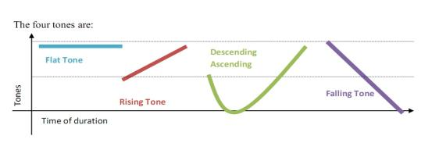
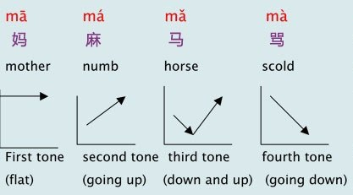
What are tones
Tone is one of the most important components in Chinese. There are 4 tones： Flat tone, Rising tone, Descending Ascending tone, Falling tone：
Notes:
第一声: flat and high pitch microwave ding 妈，叮
第二声: low to high: what? 人
第三声: go down first and go up: well, uh huh: 我，你，好
第四声: falling tone (angry tone) - go all the way down: No! 不，是

Slide 6

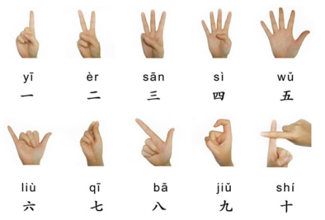
Numbers
Gesture with pronouciation
0 - ring
1 - first syllable of evening
2 - Are - curl tongue
3 - Sandy - First syllable San
4 - Snake - S
5 - Imaging the wind is blowing
6 - Leo - but pronounce it really fast
7 - Chili number - Chi
8 - Blow trumpet - 喇叭
9 - Falling than raising
10 - Shrimp - Sh

Slide 7
Characters
1
2
Indicative characters
3
Associative charactors
Pictographic characters

Slide 8
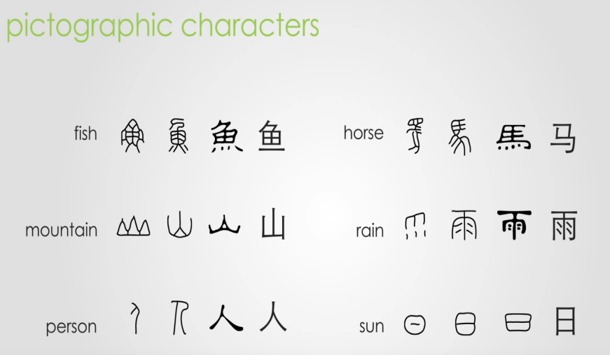
Pictographic characters

Slide 9
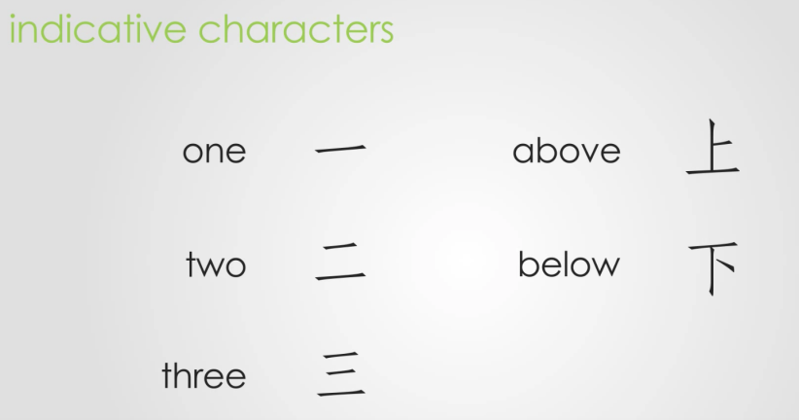
Indicative characters

Slide 10
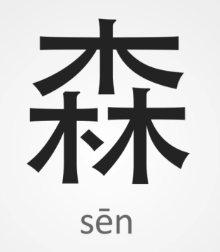
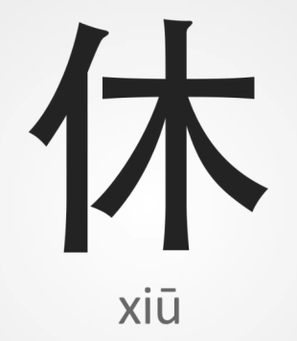
Associative charactors
Forest
To rest

Slide 11
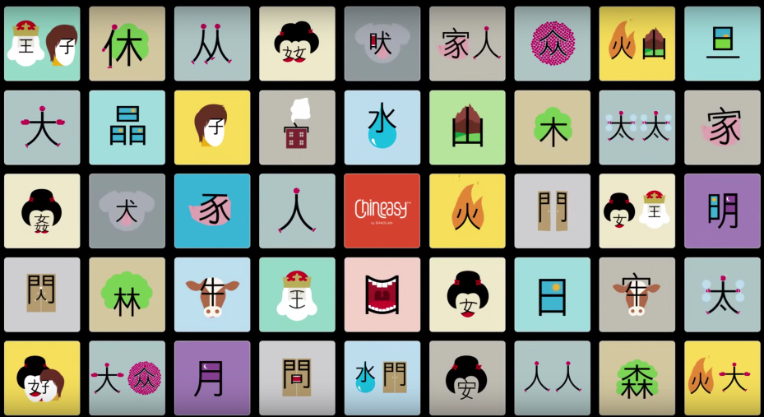
New Work

Slide 12
Questions?

